Slide 1
Shortest Paths in a Directed Graph with Positive Weights
Instructor: Kshitij Gajjar
Centre for Security, Theory and Algorithmic Research (CSTAR)
International Institute of Information Technology, Hyderabad

Slide 2










Dijkstra’s Algorithm
$$s=$$
A
A | B | C | D | E | F
$$9$$
$$1$$
C
$$5$$
B
$$7$$
$$4$$
$$2$$
E
$$1$$
$$1$$
$$3$$
D
$$6$$
F

Slide 3

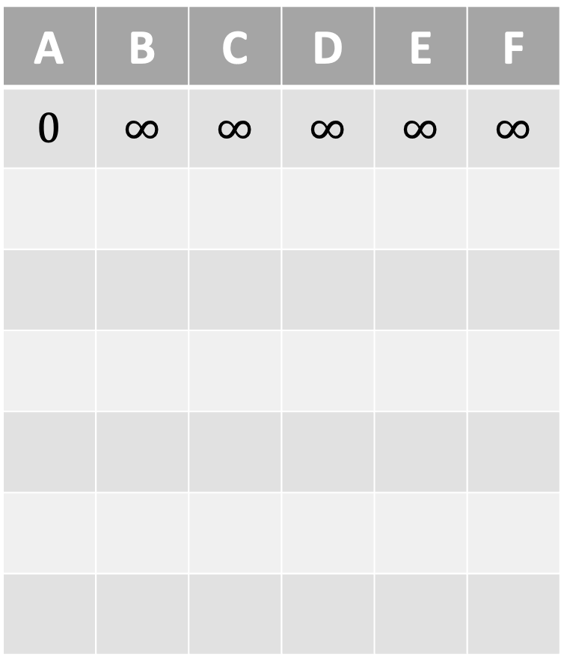
Dijkstra’s Algorithm
$$s=$$
A
A | B | C | D | E | F
$$0$$ | $$∞$$ | $$∞$$ | $$∞$$ | $$∞$$ | $$∞$$
$$9$$
$$1$$
C
$$5$$
B
$$7$$
$$4$$
$$2$$
E
$$1$$
$$1$$
$$3$$
D
$$6$$
F

Slide 4
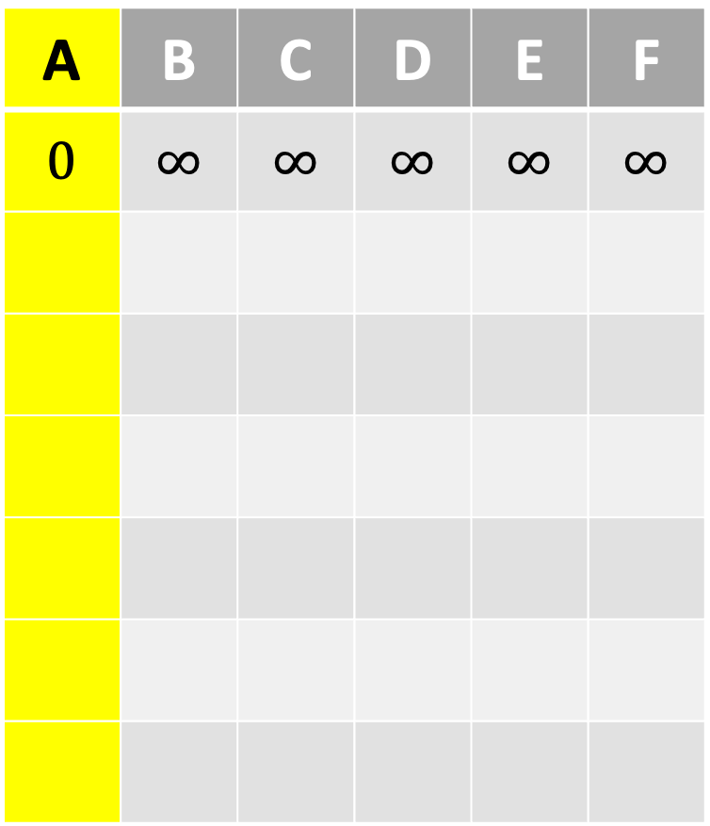
Dijkstra’s Algorithm
$$s=$$
A
A | B | C | D | E | F
$$0$$ | $$∞$$ | $$∞$$ | $$∞$$ | $$∞$$ | $$∞$$
$$9$$
$$1$$
C
$$5$$
B
$$7$$
$$4$$
$$2$$
E
$$1$$
$$1$$
$$3$$
D
$$6$$
F

Slide 5
Dijkstra’s Algorithm
$$s=$$
A
A | B | C | D | E | F
$$0$$ | $$∞$$ | $$∞$$ | $$∞$$ | $$∞$$ | $$∞$$
$$9$$
$$1$$
C
$$5$$
B
$$7$$
$$4$$
$$2$$
E
$$1$$
$$1$$
$$3$$
D
$$6$$
F

Slide 6
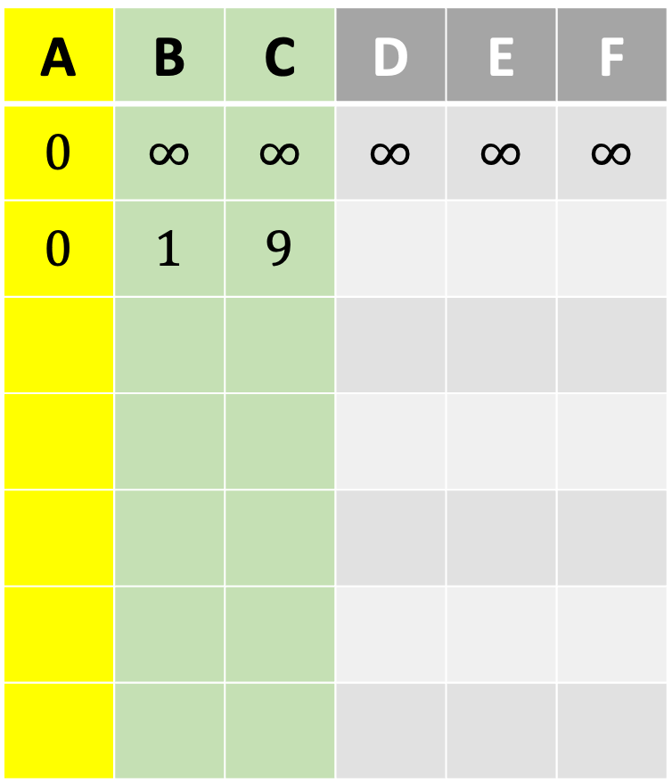
Dijkstra’s Algorithm
$$s=$$
A
A | B | C | D | E | F
$$0$$ | $$∞$$ | $$∞$$ | $$∞$$ | $$∞$$ | $$∞$$
$$0$$ | $$1$$ | $$9$$
$$9$$
$$1$$
C
$$5$$
B
$$7$$
$$4$$
$$2$$
E
$$1$$
$$1$$
$$3$$
D
$$6$$
F

Slide 7
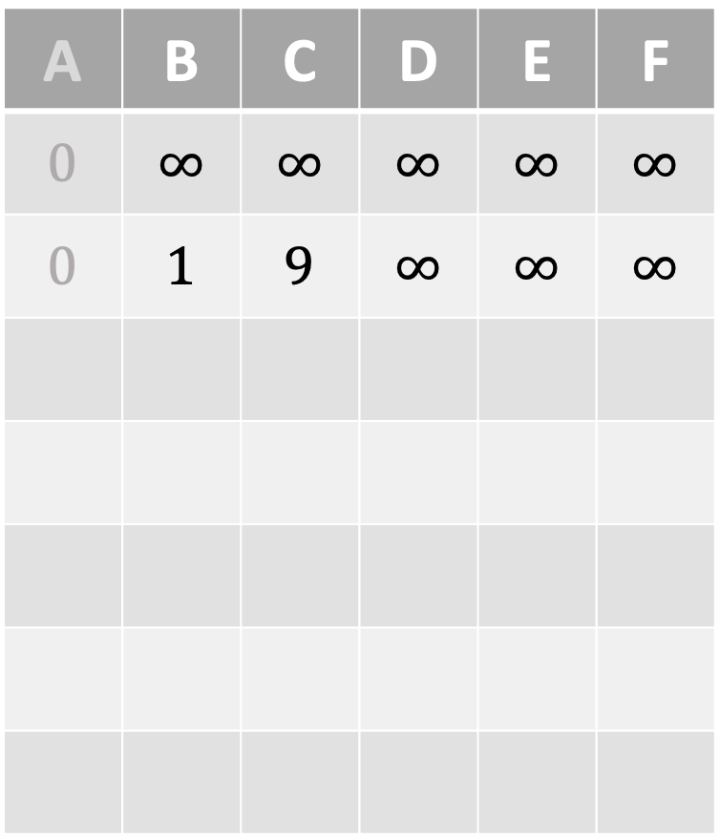
Dijkstra’s Algorithm
$$s=$$
A
A | B | C | D | E | F
$$0$$ | $$∞$$ | $$∞$$ | $$∞$$ | $$∞$$ | $$∞$$
$$0$$ | $$1$$ | $$9$$ | $$∞$$ | $$∞$$ | $$∞$$
$$9$$
$$1$$
C
$$5$$
B
$$7$$
$$4$$
$$2$$
E
$$1$$
$$1$$
$$3$$
D
$$6$$
F

Slide 8
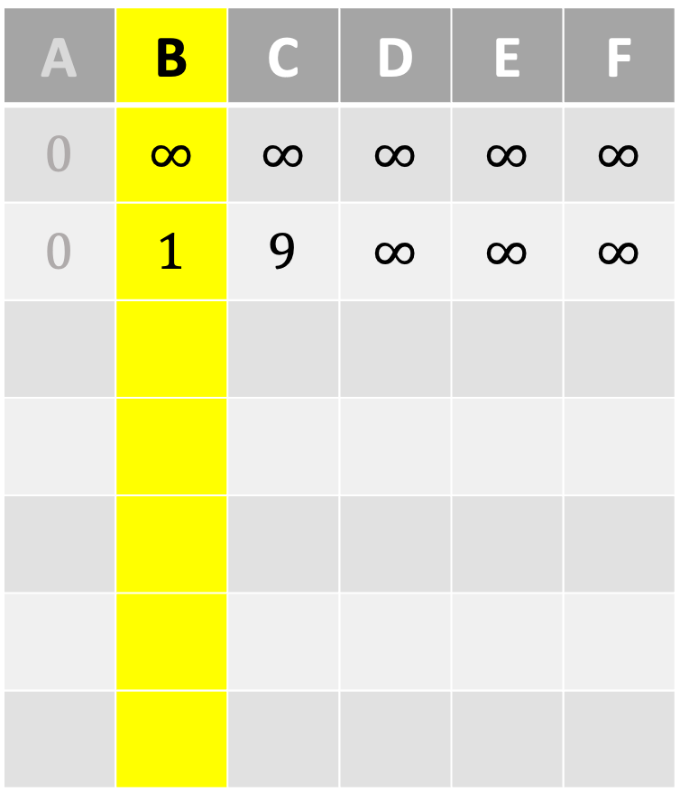
Dijkstra’s Algorithm
$$s=$$
A
A | B | C | D | E | F
$$0$$ | $$∞$$ | $$∞$$ | $$∞$$ | $$∞$$ | $$∞$$
$$0$$ | $$1$$ | $$9$$ | $$∞$$ | $$∞$$ | $$∞$$
$$9$$
$$1$$
C
$$5$$
B
$$7$$
$$4$$
$$2$$
E
$$1$$
$$1$$
$$3$$
D
$$6$$
F

Slide 9
Dijkstra’s Algorithm
$$s=$$
A
A | B | C | D | E | F
$$0$$ | $$∞$$ | $$∞$$ | $$∞$$ | $$∞$$ | $$∞$$
$$0$$ | $$1$$ | $$9$$ | $$∞$$ | $$∞$$ | $$∞$$
$$9$$
$$1$$
C
$$5$$
B
$$7$$
$$4$$
$$2$$
E
$$1$$
$$1$$
$$3$$
D
$$6$$
F

Slide 10
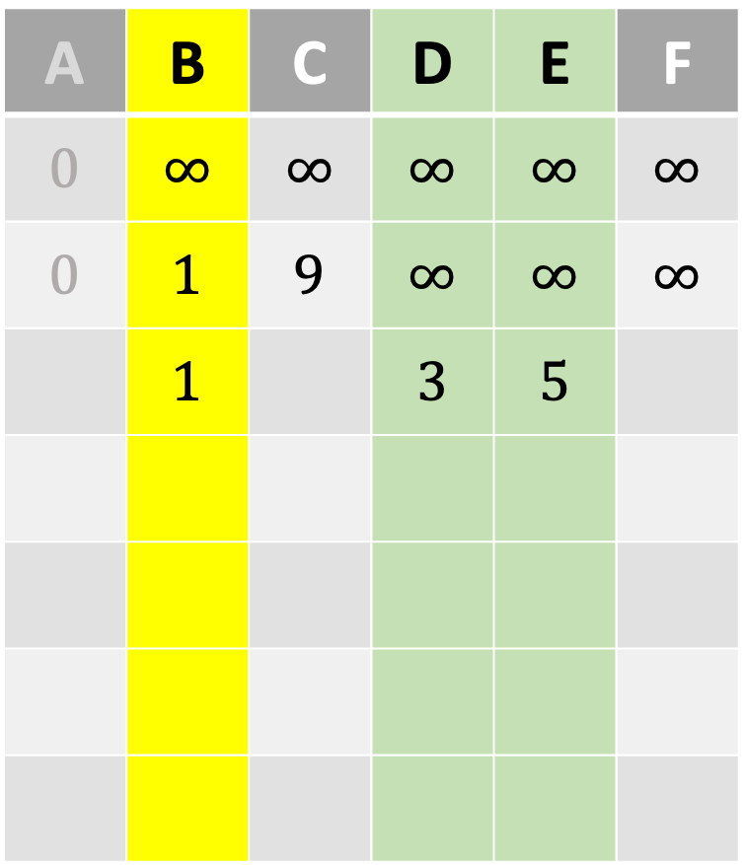
Dijkstra’s Algorithm
$$s=$$
A
A | B | C | D | E | F
$$0$$ | $$∞$$ | $$∞$$ | $$∞$$ | $$∞$$ | $$∞$$
$$0$$ | $$1$$ | $$9$$ | $$∞$$ | $$∞$$ | $$∞$$
 | $$1$$ |  | $$3$$ | $$5$$
$$9$$
$$1$$
C
$$5$$
B
$$7$$
$$4$$
$$2$$
E
$$1$$
$$1$$
$$3$$
D
$$6$$
F

Slide 11
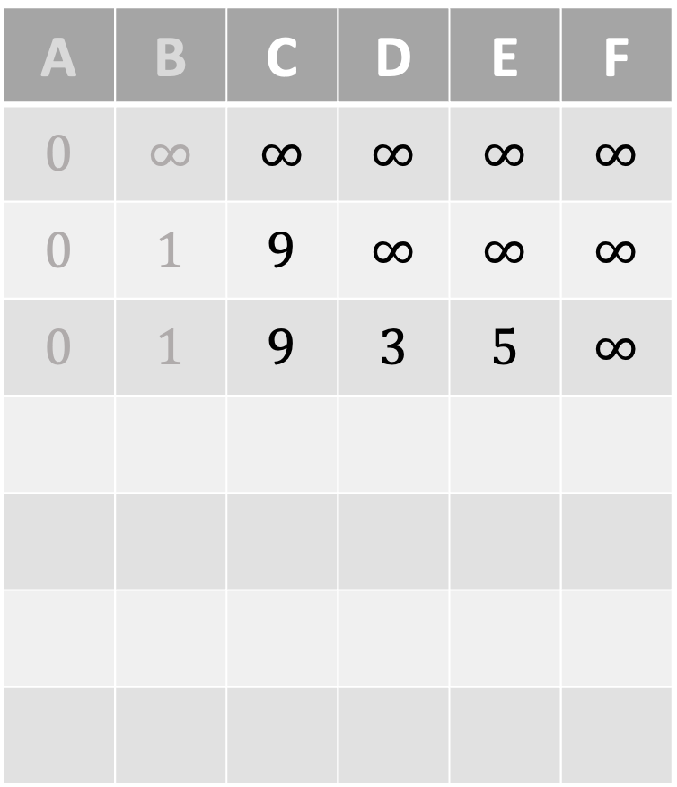
Dijkstra’s Algorithm
$$s=$$
A
A | B | C | D | E | F
$$0$$ | $$∞$$ | $$∞$$ | $$∞$$ | $$∞$$ | $$∞$$
$$0$$ | $$1$$ | $$9$$ | $$∞$$ | $$∞$$ | $$∞$$
$$0$$ | $$1$$ | $$9$$ | $$3$$ | $$5$$ | $$∞$$
$$9$$
$$1$$
C
$$5$$
B
$$7$$
$$4$$
$$2$$
E
$$1$$
$$1$$
$$3$$
D
$$6$$
F

Slide 12
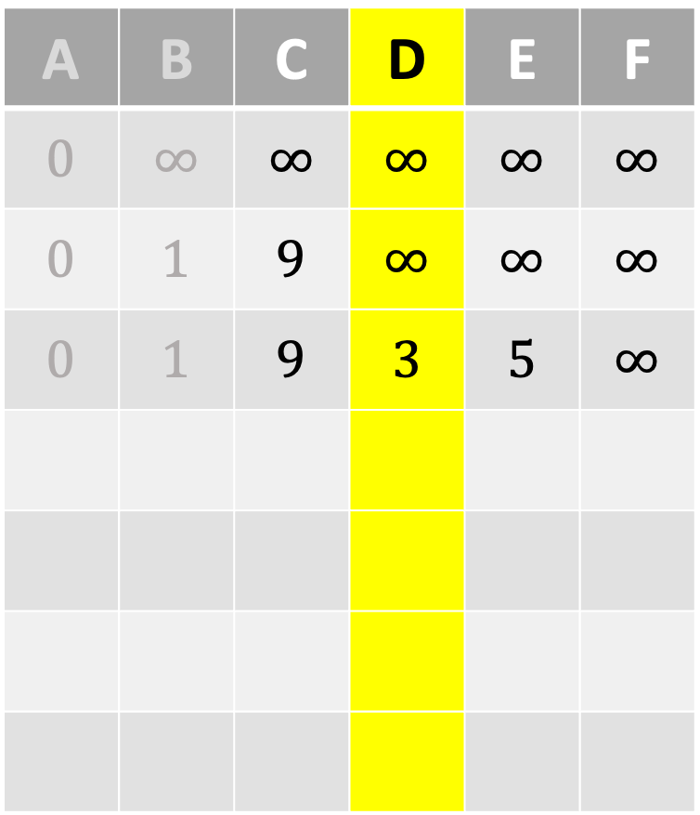
Dijkstra’s Algorithm
$$s=$$
A
A | B | C | D | E | F
$$0$$ | $$∞$$ | $$∞$$ | $$∞$$ | $$∞$$ | $$∞$$
$$0$$ | $$1$$ | $$9$$ | $$∞$$ | $$∞$$ | $$∞$$
$$0$$ | $$1$$ | $$9$$ | $$3$$ | $$5$$ | $$∞$$
$$9$$
$$1$$
C
$$5$$
B
$$7$$
$$4$$
$$2$$
E
$$1$$
$$1$$
$$3$$
D
$$6$$
F

Slide 13
Dijkstra’s Algorithm
$$s=$$
A
A | B | C | D | E | F
$$0$$ | $$∞$$ | $$∞$$ | $$∞$$ | $$∞$$ | $$∞$$
$$0$$ | $$1$$ | $$9$$ | $$∞$$ | $$∞$$ | $$∞$$
$$0$$ | $$1$$ | $$9$$ | $$3$$ | $$5$$ | $$∞$$
$$9$$
$$1$$
C
$$5$$
B
$$7$$
$$4$$
$$2$$
E
$$1$$
$$1$$
$$3$$
D
$$6$$
F

Slide 14
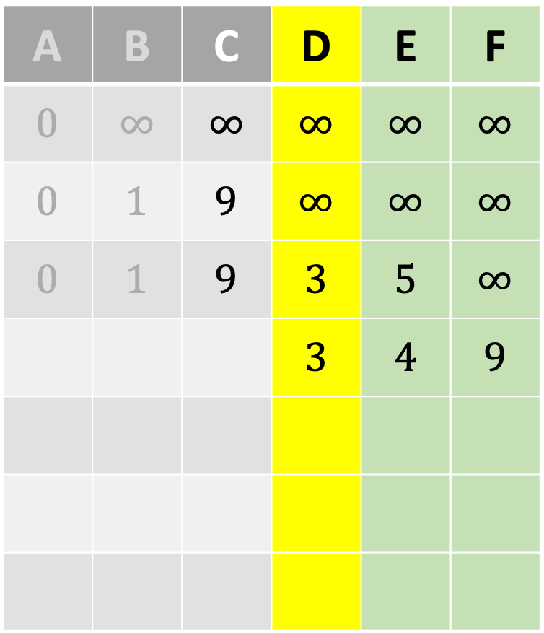
Dijkstra’s Algorithm
$$s=$$
A
A | B | C | D | E | F
$$0$$ | $$∞$$ | $$∞$$ | $$∞$$ | $$∞$$ | $$∞$$
$$0$$ | $$1$$ | $$9$$ | $$∞$$ | $$∞$$ | $$∞$$
$$0$$ | $$1$$ | $$9$$ | $$3$$ | $$5$$ | $$∞$$
 |  |  | $$3$$ | $$4$$ | $$9$$
$$9$$
$$1$$
C
$$5$$
B
$$7$$
$$4$$
$$2$$
E
$$1$$
$$1$$
$$3$$
D
$$6$$
F

Slide 15
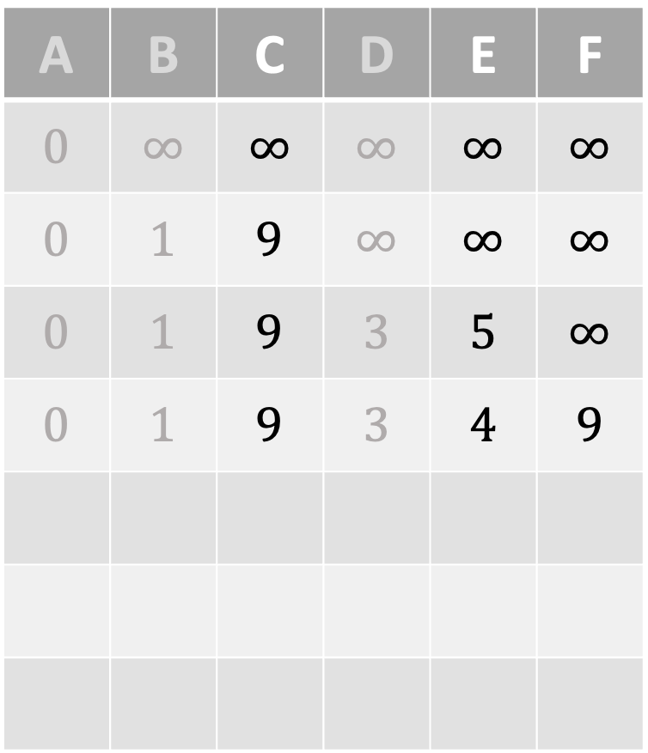
Dijkstra’s Algorithm
$$s=$$
A
A | B | C | D | E | F
$$0$$ | $$∞$$ | $$∞$$ | $$∞$$ | $$∞$$ | $$∞$$
$$0$$ | $$1$$ | $$9$$ | $$∞$$ | $$∞$$ | $$∞$$
$$0$$ | $$1$$ | $$9$$ | $$3$$ | $$5$$ | $$∞$$
$$0$$ | $$1$$ | $$9$$ | $$3$$ | $$4$$ | $$9$$
$$9$$
$$1$$
C
$$5$$
B
$$7$$
$$4$$
$$2$$
E
$$1$$
$$1$$
$$3$$
D
$$6$$
F

Slide 16
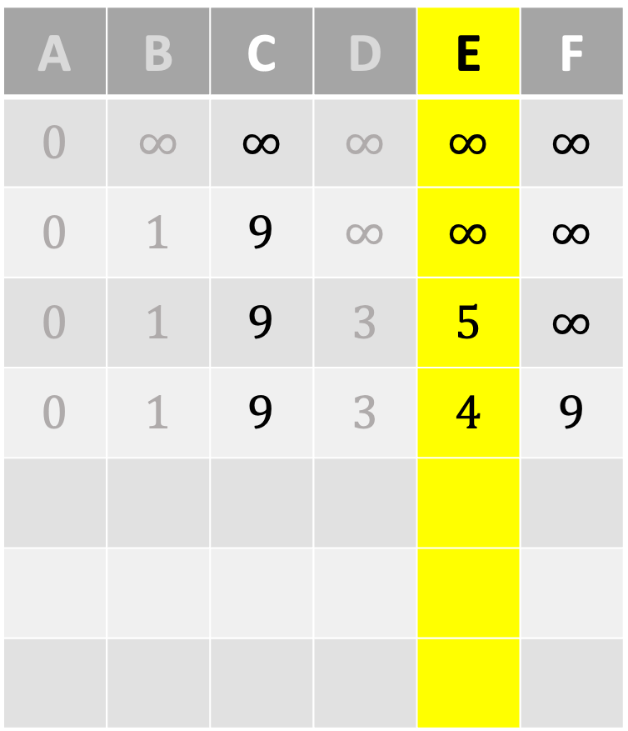
Dijkstra’s Algorithm
$$s=$$
A
A | B | C | D | E | F
$$0$$ | $$∞$$ | $$∞$$ | $$∞$$ | $$∞$$ | $$∞$$
$$0$$ | $$1$$ | $$9$$ | $$∞$$ | $$∞$$ | $$∞$$
$$0$$ | $$1$$ | $$9$$ | $$3$$ | $$5$$ | $$∞$$
$$0$$ | $$1$$ | $$9$$ | $$3$$ | $$4$$ | $$9$$
$$9$$
$$1$$
C
$$5$$
B
$$7$$
$$4$$
$$2$$
E
$$1$$
$$1$$
$$3$$
D
$$6$$
F

Slide 17
Dijkstra’s Algorithm
$$s=$$
A
A | B | C | D | E | F
$$0$$ | $$∞$$ | $$∞$$ | $$∞$$ | $$∞$$ | $$∞$$
$$0$$ | $$1$$ | $$9$$ | $$∞$$ | $$∞$$ | $$∞$$
$$0$$ | $$1$$ | $$9$$ | $$3$$ | $$5$$ | $$∞$$
$$0$$ | $$1$$ | $$9$$ | $$3$$ | $$4$$ | $$9$$
$$9$$
$$1$$
C
$$5$$
B
$$7$$
$$4$$
$$2$$
E
$$1$$
$$1$$
$$3$$
D
$$6$$
F

Slide 18
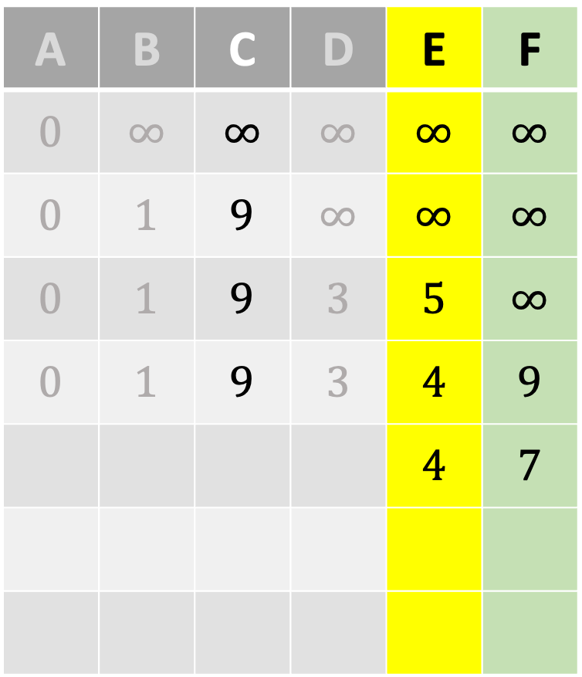
Dijkstra’s Algorithm
$$s=$$
A
A | B | C | D | E | F
$$0$$ | $$∞$$ | $$∞$$ | $$∞$$ | $$∞$$ | $$∞$$
$$0$$ | $$1$$ | $$9$$ | $$∞$$ | $$∞$$ | $$∞$$
$$0$$ | $$1$$ | $$9$$ | $$3$$ | $$5$$ | $$∞$$
$$0$$ | $$1$$ | $$9$$ | $$3$$ | $$4$$ | $$9$$
 |  |  |  | $$4$$ | $$7$$
$$9$$
$$1$$
C
$$5$$
B
$$7$$
$$4$$
$$2$$
E
$$1$$
$$1$$
$$3$$
D
$$6$$
F

Slide 19
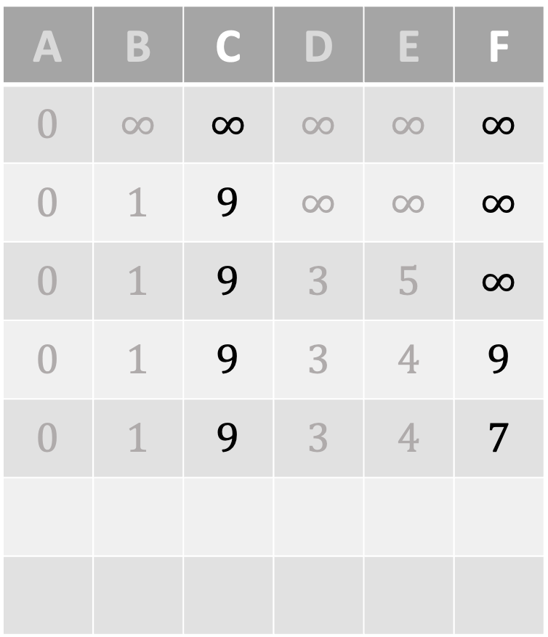
Dijkstra’s Algorithm
$$s=$$
A
A | B | C | D | E | F
$$0$$ | $$∞$$ | $$∞$$ | $$∞$$ | $$∞$$ | $$∞$$
$$0$$ | $$1$$ | $$9$$ | $$∞$$ | $$∞$$ | $$∞$$
$$0$$ | $$1$$ | $$9$$ | $$3$$ | $$5$$ | $$∞$$
$$0$$ | $$1$$ | $$9$$ | $$3$$ | $$4$$ | $$9$$
$$0$$ | $$1$$ | $$9$$ | $$3$$ | $$4$$ | $$7$$
$$9$$
$$1$$
C
$$5$$
B
$$7$$
$$4$$
$$2$$
E
$$1$$
$$1$$
$$3$$
D
$$6$$
F

Slide 20
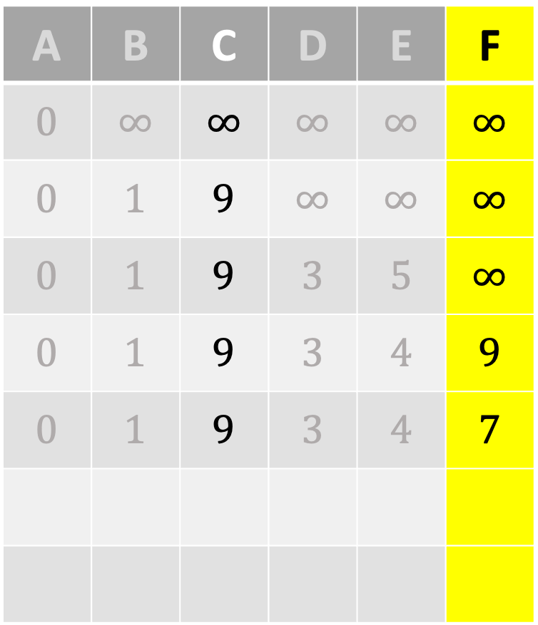
Dijkstra’s Algorithm
$$s=$$
A
A | B | C | D | E | F
$$0$$ | $$∞$$ | $$∞$$ | $$∞$$ | $$∞$$ | $$∞$$
$$0$$ | $$1$$ | $$9$$ | $$∞$$ | $$∞$$ | $$∞$$
$$0$$ | $$1$$ | $$9$$ | $$3$$ | $$5$$ | $$∞$$
$$0$$ | $$1$$ | $$9$$ | $$3$$ | $$4$$ | $$9$$
$$0$$ | $$1$$ | $$9$$ | $$3$$ | $$4$$ | $$7$$
$$9$$
$$1$$
C
$$5$$
B
$$7$$
$$4$$
$$2$$
E
$$1$$
$$1$$
$$3$$
D
$$6$$
F

Slide 21
Dijkstra’s Algorithm
$$s=$$
A
A | B | C | D | E | F
$$0$$ | $$∞$$ | $$∞$$ | $$∞$$ | $$∞$$ | $$∞$$
$$0$$ | $$1$$ | $$9$$ | $$∞$$ | $$∞$$ | $$∞$$
$$0$$ | $$1$$ | $$9$$ | $$3$$ | $$5$$ | $$∞$$
$$0$$ | $$1$$ | $$9$$ | $$3$$ | $$4$$ | $$9$$
$$0$$ | $$1$$ | $$9$$ | $$3$$ | $$4$$ | $$7$$
$$9$$
$$1$$
C
$$5$$
B
$$7$$
$$4$$
$$2$$
E
$$1$$
$$1$$
$$3$$
D
$$6$$
F

Slide 22
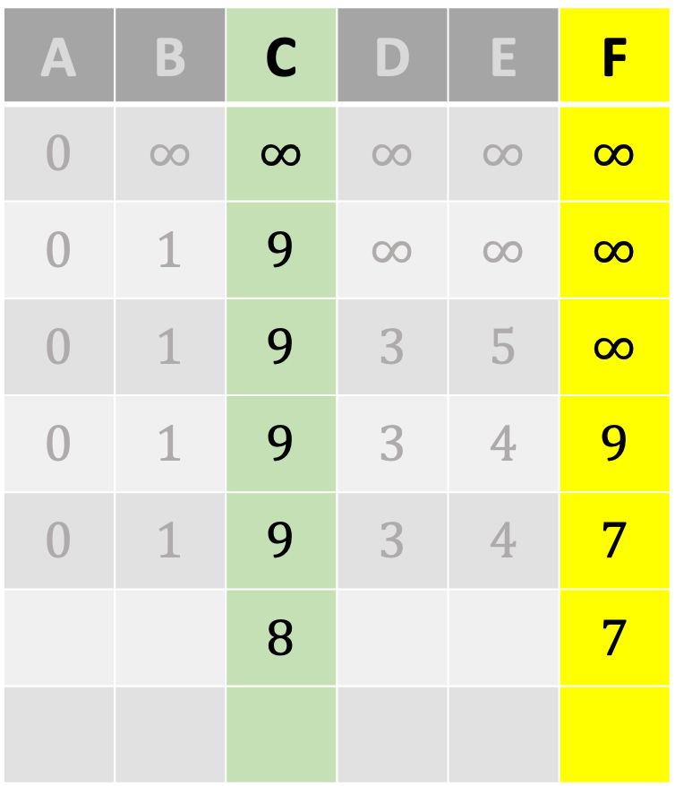
Dijkstra’s Algorithm
$$s=$$
A
A | B | C | D | E | F
$$0$$ | $$∞$$ | $$∞$$ | $$∞$$ | $$∞$$ | $$∞$$
$$0$$ | $$1$$ | $$9$$ | $$∞$$ | $$∞$$ | $$∞$$
$$0$$ | $$1$$ | $$9$$ | $$3$$ | $$5$$ | $$∞$$
$$0$$ | $$1$$ | $$9$$ | $$3$$ | $$4$$ | $$9$$
$$0$$ | $$1$$ | $$9$$ | $$3$$ | $$4$$ | $$7$$
 |  | $$8$$ |  |  | $$7$$
$$9$$
$$1$$
C
$$5$$
B
$$7$$
$$4$$
$$2$$
E
$$1$$
$$1$$
$$3$$
D
$$6$$
F

Slide 23
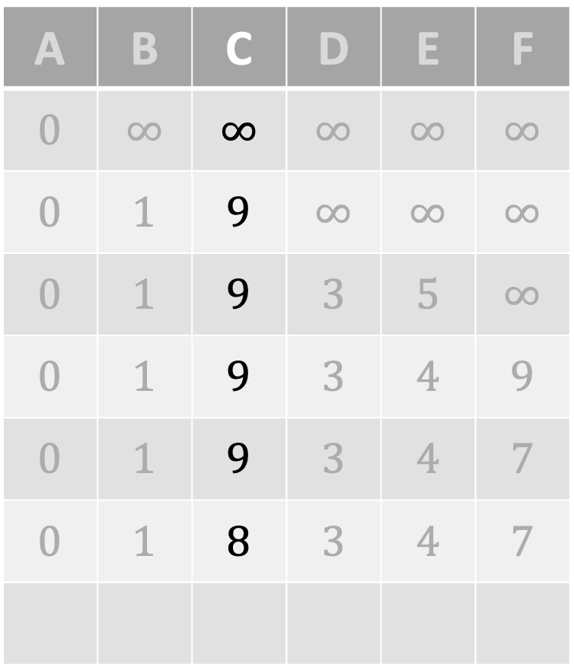
Dijkstra’s Algorithm
$$s=$$
A
A | B | C | D | E | F
$$0$$ | $$∞$$ | $$∞$$ | $$∞$$ | $$∞$$ | $$∞$$
$$0$$ | $$1$$ | $$9$$ | $$∞$$ | $$∞$$ | $$∞$$
$$0$$ | $$1$$ | $$9$$ | $$3$$ | $$5$$ | $$∞$$
$$0$$ | $$1$$ | $$9$$ | $$3$$ | $$4$$ | $$9$$
$$0$$ | $$1$$ | $$9$$ | $$3$$ | $$4$$ | $$7$$
$$0$$ | $$1$$ | $$8$$ | $$3$$ | $$4$$ | $$7$$
$$9$$
$$1$$
C
$$5$$
B
$$7$$
$$4$$
$$2$$
E
$$1$$
$$1$$
$$3$$
D
$$6$$
F

Slide 24
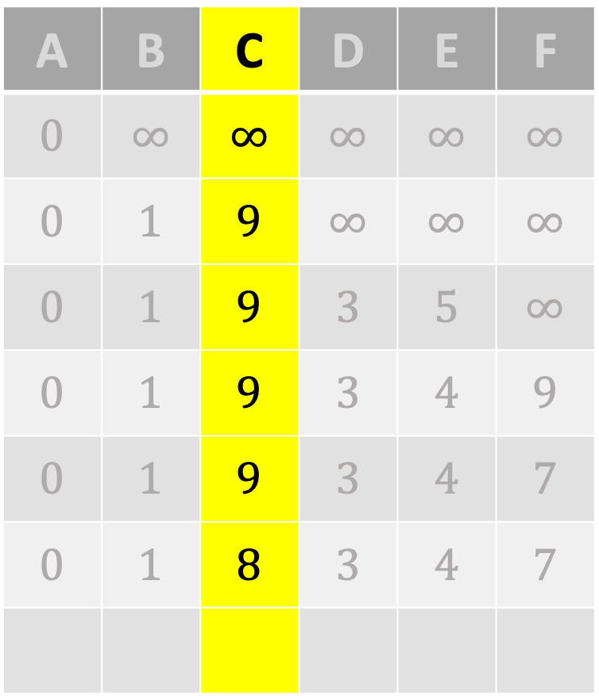
Dijkstra’s Algorithm
$$s=$$
A
A | B | C | D | E | F
$$0$$ | $$∞$$ | $$∞$$ | $$∞$$ | $$∞$$ | $$∞$$
$$0$$ | $$1$$ | $$9$$ | $$∞$$ | $$∞$$ | $$∞$$
$$0$$ | $$1$$ | $$9$$ | $$3$$ | $$5$$ | $$∞$$
$$0$$ | $$1$$ | $$9$$ | $$3$$ | $$4$$ | $$9$$
$$0$$ | $$1$$ | $$9$$ | $$3$$ | $$4$$ | $$7$$
$$0$$ | $$1$$ | $$8$$ | $$3$$ | $$4$$ | $$7$$
$$9$$
$$1$$
C
$$5$$
B
$$7$$
$$4$$
$$2$$
E
$$1$$
$$1$$
$$3$$
D
$$6$$
F

Slide 25
Dijkstra’s Algorithm
$$s=$$
A
A | B | C | D | E | F
$$0$$ | $$∞$$ | $$∞$$ | $$∞$$ | $$∞$$ | $$∞$$
$$0$$ | $$1$$ | $$9$$ | $$∞$$ | $$∞$$ | $$∞$$
$$0$$ | $$1$$ | $$9$$ | $$3$$ | $$5$$ | $$∞$$
$$0$$ | $$1$$ | $$9$$ | $$3$$ | $$4$$ | $$9$$
$$0$$ | $$1$$ | $$9$$ | $$3$$ | $$4$$ | $$7$$
$$0$$ | $$1$$ | $$8$$ | $$3$$ | $$4$$ | $$7$$
$$9$$
$$1$$
C
$$5$$
B
$$7$$
$$4$$
$$2$$
E
$$1$$
$$1$$
$$3$$
D
$$6$$
F

Slide 26
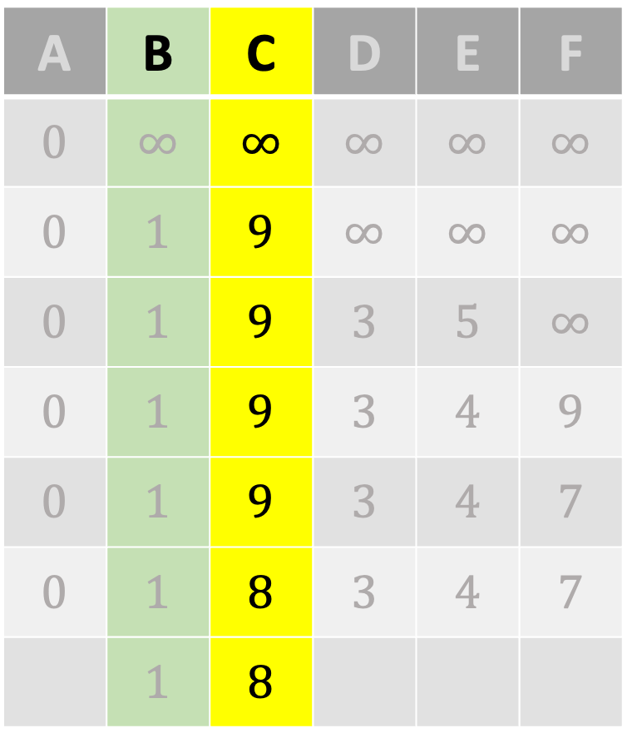
Dijkstra’s Algorithm
$$s=$$
A
A | B | C | D | E | F
$$0$$ | $$∞$$ | $$∞$$ | $$∞$$ | $$∞$$ | $$∞$$
$$0$$ | $$1$$ | $$9$$ | $$∞$$ | $$∞$$ | $$∞$$
$$0$$ | $$1$$ | $$9$$ | $$3$$ | $$5$$ | $$∞$$
$$0$$ | $$1$$ | $$9$$ | $$3$$ | $$4$$ | $$9$$
$$0$$ | $$1$$ | $$9$$ | $$3$$ | $$4$$ | $$7$$
$$0$$ | $$1$$ | $$8$$ | $$3$$ | $$4$$ | $$7$$
 | $$1$$ | $$8$$
$$9$$
$$1$$
C
$$5$$
B
$$7$$
$$4$$
$$2$$
E
$$1$$
$$1$$
$$3$$
D
$$6$$
F

Slide 27
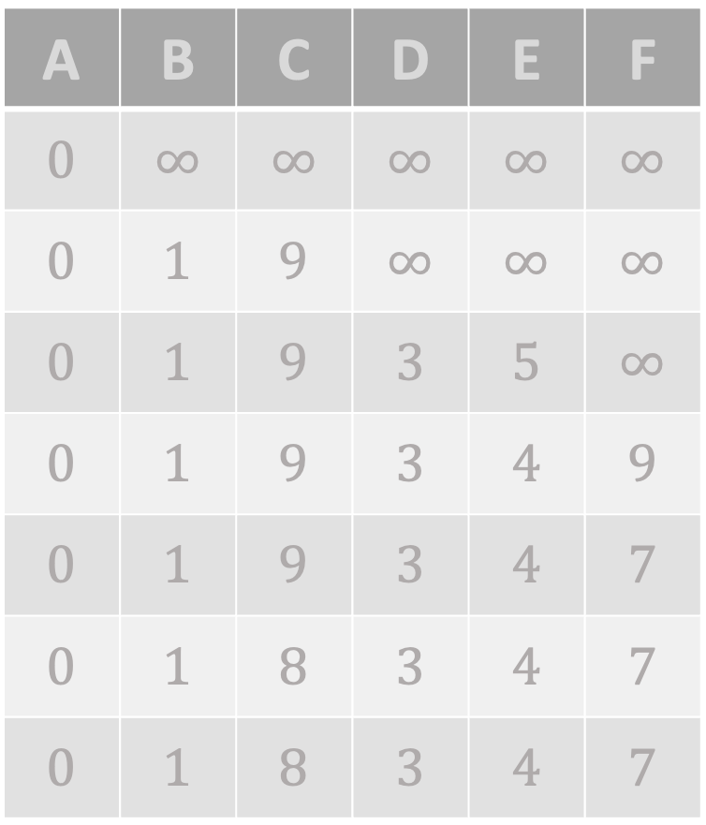
Dijkstra’s Algorithm
$$s=$$
A
A | B | C | D | E | F
$$0$$ | $$∞$$ | $$∞$$ | $$∞$$ | $$∞$$ | $$∞$$
$$0$$ | $$1$$ | $$9$$ | $$∞$$ | $$∞$$ | $$∞$$
$$0$$ | $$1$$ | $$9$$ | $$3$$ | $$5$$ | $$∞$$
$$0$$ | $$1$$ | $$9$$ | $$3$$ | $$4$$ | $$9$$
$$0$$ | $$1$$ | $$9$$ | $$3$$ | $$4$$ | $$7$$
$$0$$ | $$1$$ | $$8$$ | $$3$$ | $$4$$ | $$7$$
$$0$$ | $$1$$ | $$8$$ | $$3$$ | $$4$$ | $$7$$
$$9$$
$$1$$
C
$$5$$
B
$$7$$
$$4$$
$$2$$
E
$$1$$
$$1$$
$$3$$
D
$$6$$
F

Slide 28
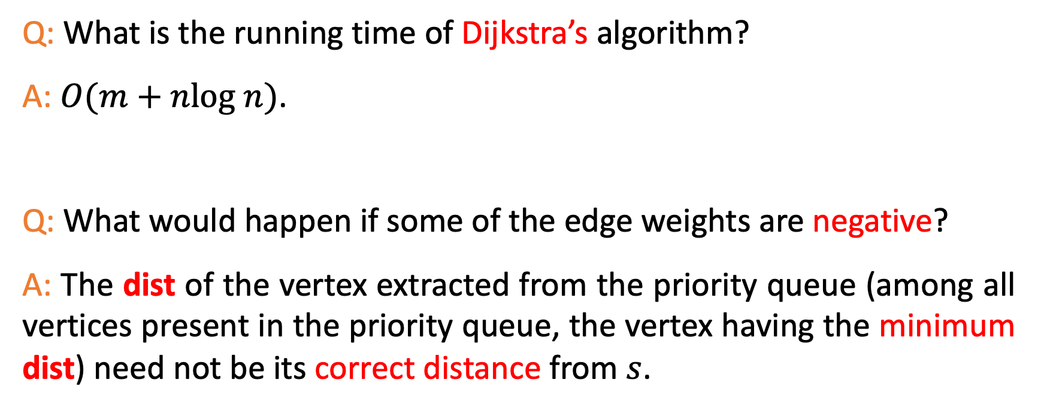
A Puzzle
Q: What is the running time of Dijkstra’s algorithm?
A: $O(m+nlog n)$.
Q: What would happen if some of the edge weights are negative?
A: The dist of the vertex extracted from the priority queue (among all vertices present in the priority queue, the vertex having the minimum dist) need not be its correct distance from $s$.

Slide 29

Thank You!

